Slide 1
EMEP stations as part of National Monitoring System in Poland
Anna Degorska
Institute of Environmental Protection – NRI
Barbara Toczko
Chief Inspectorate of Environmental Protection
TFMM Meeting, Krakow 5.05.2015

Slide 2
National Monitoring System in Poland has been organised based on:
EMEP monitoring strategy (rural background stations for EMEP and WMO GAW )
EU directives (since 2004):
directive 2008/50/EC of the European Parliament and the Council of 21 May 2008 on ambient air quality and cleaner air for Europe (Framework Directive 96/62/EC and daughter directives at the beginning)
directive 2004/107/EC of the European Parliament and the Council of 15 December 2004 relating to arsenic, cadmium, mercury, nickel and polycyclic aromatic hydrocarbons in ambient air

Slide 3
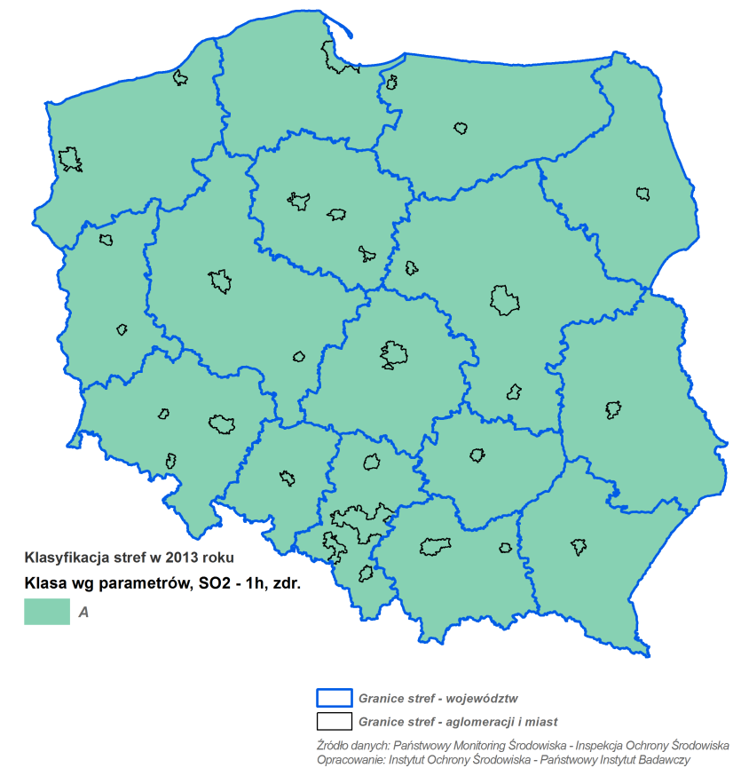
Zones in Poland established for the purpose of air quality assessment
46 zones for health protection:
agglomeration with a population over 250 000 inhabitants (12)
city with a population over 100 000 inhabitants (18)
rest of the voivodeship area (16)
since 2010
&
16 zones for ecosystem protection
Source: Chief Inspectorate of Environmental Protection, 2014

Slide 4
PL04
PL05
* end of operation in 1994
PL01
urban background station
PL02
rural background station
PL03
EMEP station
Source: Chief Inspectorate of Environmental Protection, 2015

Slide 5
Station | Height a.s.l. [m] | Region | Owner of the station | Start time of BAPMON/GAW measurements | Start time of EMEP measurements | Precipitation site code GAW/WMO | WDCGG code | EMEP symbol
Suwałki | 187 | lake region | IM&WM | 01.11.1975 | 01.04.1978 | PL8000101Q08 | SWL654N00 | PL01
Jarczew | 180 | agricultural region | IM&WM | 01.01.1984 | 01.10.1985 | PL4500101Q08 | JCZ651N00 | PL02
Śnieżka | 1603 | high mountains | IM&WM | 01.01.1981 | 01.01.1991 | PL5000101Q08 | SNZ650N00 | PL03
Łeba | 2 | sea side | IM&WM | 01.01.1993 | 01.01.1993 | PL4000101Q08 | LEB654N00 | PL04
Puszcza Borecka | 153 | lake region | IEP | 01.01.1993 | 01.07.1992 | PL5500101Q08 | DIG654N00 | PL05
IM&WM - Institute of Meteorology and Water Management
IEP - Institute of Environmental Protection
EMEP stations are operated by scientific institutes, other stations by Inspection of Environmental Protection (regional inspectorates in voivodeships)
EMEP stations – one of the oldest in monitoring system

Slide 6
1 EMEP
4 EMEP
1 EMEP
Source: Chief Inspectorate of Environmental Protection, 2015

Slide 7
EMEP
Results from automatic analysers are available as NRT data at EEA
Source: Chief Inspectorate of Environmental Protection, 2015

Slide 8
1 EMEP
1 EMEP
1 EMEP
1 EMEP
1 EMEP
4 EMEP
Source: Chief Inspectorate of Environmental Protection, 2015

Slide 9
HM and PAHs monitoring
 |  | B(a)A | B(a)P | B(b)F | B(j)F | B(k)F | D(a,h)A | I(1,2,3-cd)P
PM10 | urban | 25 | 130 | 25 | 25 | 25 | 25 | 25
 | background | 3 | 5 | 3 | 3 | 3 | 3 | 3
total deposition | background | 3 | 3 | 3 | 3 | 3 | 3 | 3
 |  | As | Cd | Ni | Hg
PM10 | urban | 94 | 92 | 92 | 0
 | background | 5 | 5 | 5 | 5
total deposition | background | 3 | 3 | 3 | 3
1 EMEP
Proposal: 1 EMEP co-located for PM10
+1 EMEP wet deposition
Source: Chief Inspectorate of Environmental Protection, 2015

Slide 10
Rural background stations
 | anions | cations | EC&OC
 | SO₄²⁻, NO₃⁻, Cl⁻ | NH₄⁺, Ca²⁺, Mg²⁺, Na⁺, K⁺
PM2,5 | 4 | 4 | 4
1 EMEP
Proposal: 1 EMEP co-located
Source: Chief Inspectorate of Environmental Protection, 2015

Slide 11
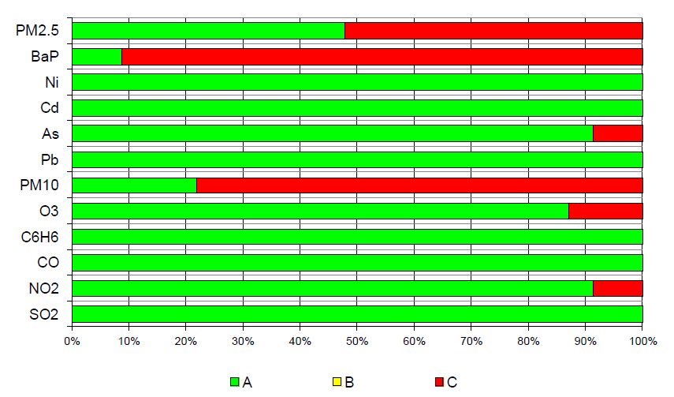
Air quality in Poland – assessment for 2013
health protection
Source: Chief Inspectorate of Environmental Protection, 2014

Slide 12
Air quality in Poland – assessment for 2013
health protection
Despite the systematic improvement of air quality in Poland the significant problem remine:
in the winter season - oversize concentrations of PM10 and benzo(a)pyrene in PM10 (mainly due to individual heating)
in the winter season - oversize concentrations of PM2.5 particulate matter (mainly due to individual heating)
high concentrations of nitrogen dioxide in cities (communication )
in summer - too high concentrations of tropospheric ozone (due to the meteorological conditions)
Source: Chief Inspectorate of Environmental Protection, 2014

Slide 13
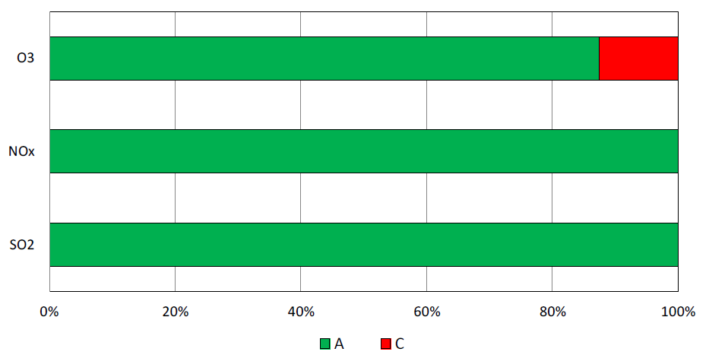
Air quality in Poland – assessment for 2013
ecosystem protection
O3
NOx
SO2
Source: Chief Inspectorate of Environmental Protection, 2014

Slide 14
SO2 concentration at Polish EMEP stations follow emission trends very well
Source: Institute of Meteorology and Water Management, Chief Inspectorate of Environmental Protection & CEIP EMEP

Slide 15
NO2 concentration at Polish EMEP stations follow emission trends quite well
Source: Institute of Meteorology and Water Management, Chief Inspectorate of Environmental Protection & CEIP EMEP

Slide 16
PM2,5 composition at background stations in 2013
Source: Chief Inspectorate of Environmental Protection, 2014

Slide 17
The supporting of the air quality monitoring system with modelling methods
The system of annual air quality assessments is supported by modelling methods for ozone and its precursors.
Modeling is performed for the area of the whole country and for individual voivodships.
It helps to identify and define the areas of exceedances for ozone and estimate number of people exposed to oversize concentration.
Further work regarding other compounds (f.e. PM) for the whole country has been undertaken.
In some voivodhips model results of PM10, PM2,5, SO2, NO2, NOx, CO, heavy metals and benzo(a)pyrene have been used to support air quality assessment on regular basis.

Slide 18
www.krakow.pl
Thank you for attention!

